Slide 1
Regular expression to ∈-NFA

Slide 2
Regular Expressions
A Regular Expression can be recursively defined as follows −
ε is a Regular Expression indicates the language containing an empty string. (L (ε) = {ε})
φ is a Regular Expression denoting an empty language. (L (φ) = { })
x is a Regular Expression where L = {x}
If X is a Regular Expression denoting the language L(X) and Y is a Regular Expression denoting the language L(Y), then - X + Y is a Regular Expression corresponding to the language L(X) ∪ L(Y) where L(X+Y) = L(X) ∪ L(Y). - X . Y is a Regular Expression corresponding to the language L(X) . L(Y) where L(X.Y) = L(X) . L(Y) - R* is a Regular Expression corresponding to the language L(R*)where L(R*) = (L(R))*
If we apply any of the rules several times from 1 to 5, they are Regular Expressions.

Slide 3
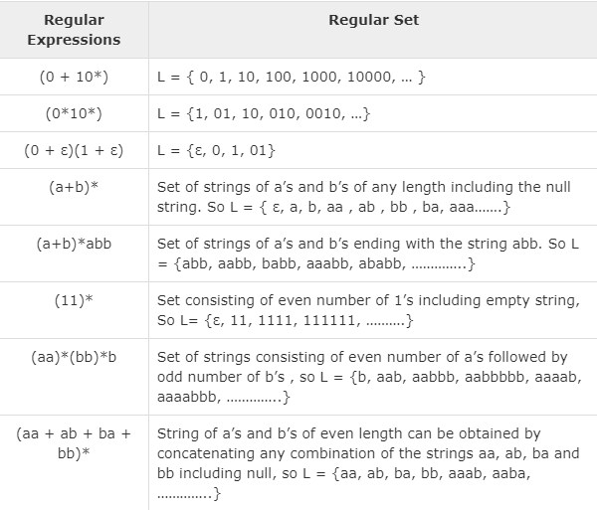
Some Re Examples

Slide 4
One way to implement regular expressions is to convert them into a finite automaton, known as an ∈-NFA (epsilon-NFA). An ∈-NFA is a type of automaton that allows for the use of “epsilon” transitions, which do not consume any input. This means that the automaton can move from one state to another without consuming any characters from the input string.

Slide 5
The process of converting a regular expression into an ∈-NFA is as follows:
Create a single start state for the automaton, and mark it as the initial state.
For each character in the regular expression, create a new state and add an edge between the previous state and the new state, with the character as the label.
For each operator in the regular expression (such as “*” for zero or more, “+” for one or more, and “?” for zero or one), create new states and add the appropriate edges to represent the operator.
Mark the final state as the accepting state, which is the state that is reached when the regular expression is fully matched.

Slide 6
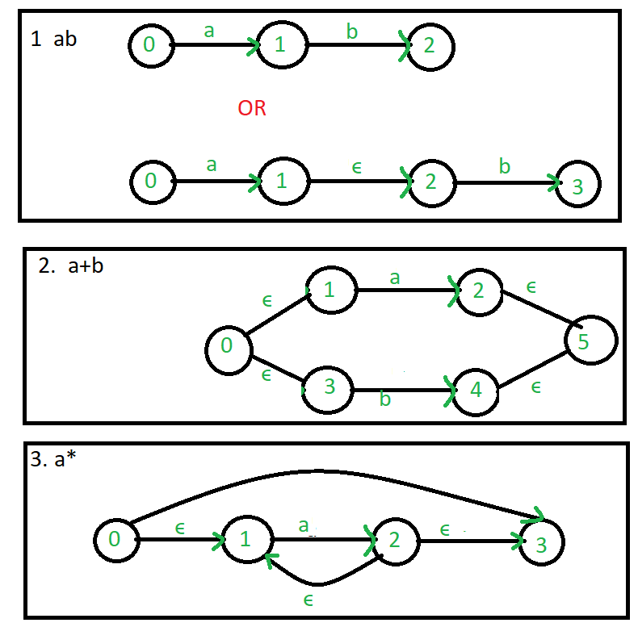
Common regular expression used in make ∈-NFA:

Slide 7
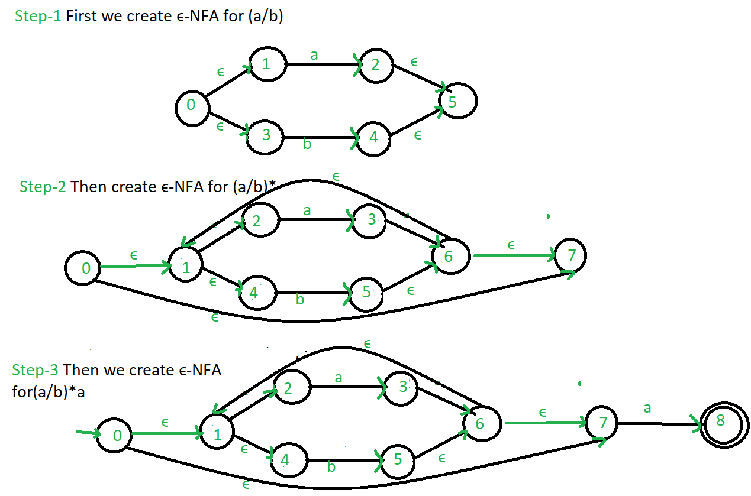
Example: Create a ∈-NFA for regular expression: (a/b)*a

